Slide 1
Sales Kit
The best way to show Massivit applications

Slide 2
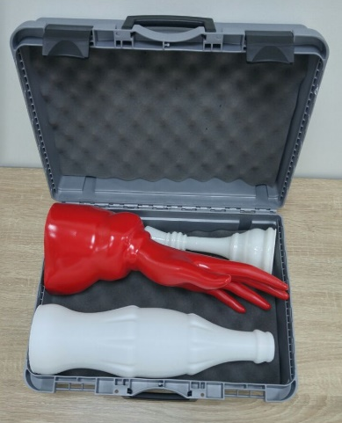
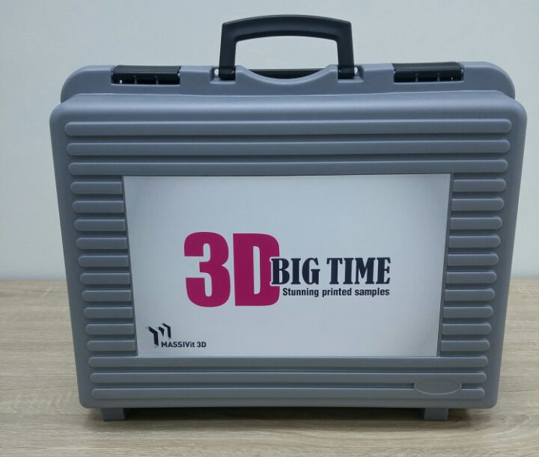
Massivit Sales Kit
Massivit Sales kit includes 3 models:
Bottle
Chess King
Palm
The best way to show customers the Massivit printed models and finishing options

Slide 3
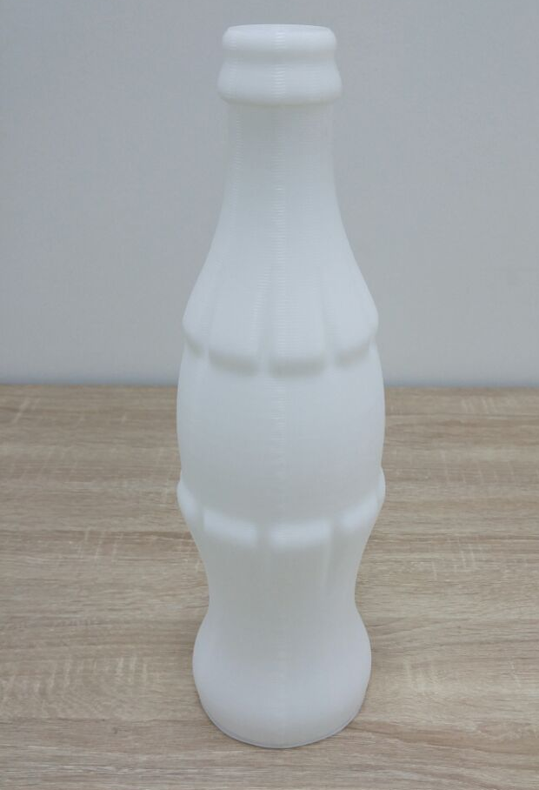
Bottle Sample
Application – Preview of unfinished sample
Height : 37 cm; 14.5 inch
Weight: 295 gr / 0.66 pound
Printing Time: 35 min
Finishing process: Sample showing 3D output of our printer without any finishing

Slide 4
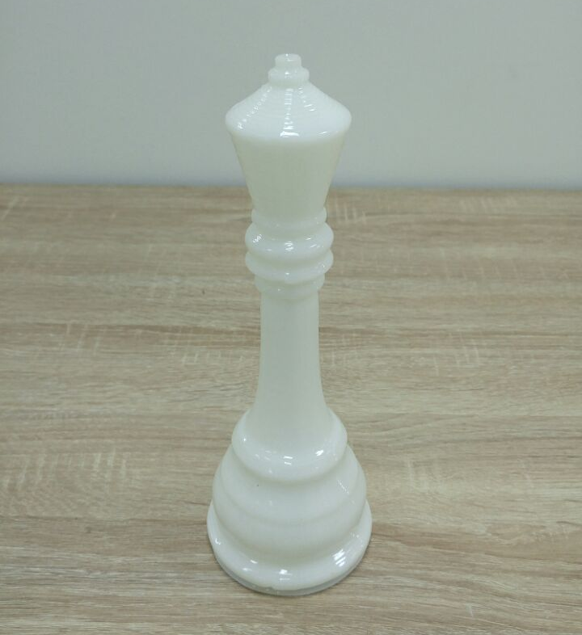
Chess king
Application: Sample of Minimal Finishing
Height: 25 cm; 9.8 inch
Weight: 80gr / 0.17 pound
Printing Speed: 13 min
Finishing process: Sample was sprayed with Polyurea for a quick gloss finish

Slide 5
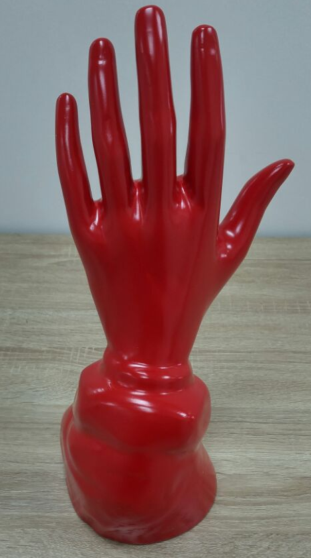
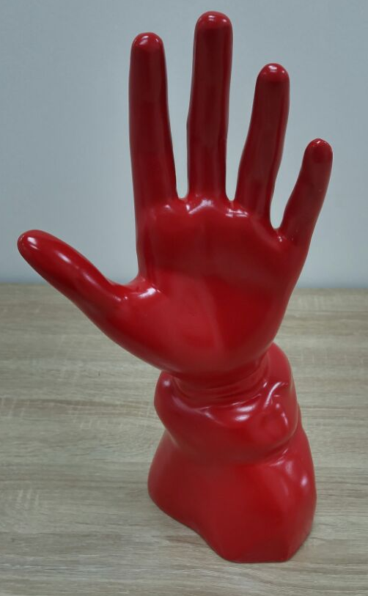
Palm Printed Sample
Application: Sample of High Gloss Finish
Height : 41 cm; 16.1 inch
Weight: 701 gr / 1.54 pound
Printing Time: 1:24 min
Finishing process: Sample was filled with Polyurethane, then primed, sanded and painted

